Slide 1


How to complete the “Shipper’s Letter of Instructions” Form (SLI)”
Turn up the volume on your computer and play the slideshow.
Notes:
This presentation will guide you through the process of completing a Shipper’s Letter of Instructions.
Please turn the volume up on your computer and play the slideshow.
It is important that we obtain from YOU, the shipper, an SLI as it is your written instructions to Walker International Transportation, your freight forwarder, specifying the details of the shipment as well as the handling requirements.
Due to U.S. Government regulations, if we do not receive a properly completed and signed SLI, we are unable to arrange the transportation of your shipment.

Slide 2
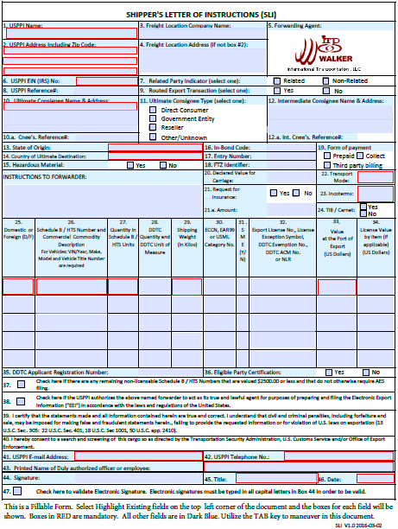
SLI FORM
Our SLI form is a PDF fillable form. Please download the form from our website.
www.walkerscm.com/trade-tools/
Notes:
The next 3 slides are an index of the content of this presentation. The SLI form is available on our website at www.walkerscm.com/trade-tools/
The data fields that are detailed are indicated by slide. You can skip the slide show and move to the desired slide and select the “SPEAKER” icon in the top right corner of the slide to obtain the information pertaining to the data elements on that slide.

Slide 3
Index
SLI is available at www.walkerscm.com/trade-tools/
Field Numbers | Content | Slide Number
1 through 4 | USPPI Details; Freight Location | 5
6 through 9 | USPPI EIN (IRS) No, Related Parties, Routed Transactions | 6
10 through 12.a | Ultimate Consignee; Consignee Type, Intermediate Consignee | 7
13 through 19 | State of Origin, Country of Ultimate Destination, Hazardous Material, In-Bond Code, Entry Number, FTZ Identifier, Form of Payment | 8
20 through 24 & Handling Instructions | Instructions to Forwarder, Declared Value for Carriage, Request for Insurance, Transport Mode, Incoterms, TIB/Carnet | 9
Notes:
The next 3 slides are an index of the content of this presentation. The SLI form is available on our website at www.walkerscm.com/trade-tools/
The data fields that are detailed are indicated by slide. You can skip the slide show and move to the desired slide and select the “SPEAKER” icon in the top right corner of the slide to obtain the information pertaining to the data elements on that slide.

Slide 4
Index
SLI is available at www.walkerscm.com/trade-tools/
Field Numbers | Content | Slide Number
25 through 29 | Domestic/Foreign, Schedule B/HTS number & description; Schedule B quantity, DDTC Quantity, Shipping Weight | 10
30 through 32 | ECCN, EAR99, USML Category, SME, Export License or Exemption | 11
33 through 34 | Value – Port of Export, Export License Value | 12
35 through 38 | DDTC Application Registration No., Eligible Party Certification; Goods under $2500; EEI (AES ) filing authorization | 13

Slide 5
Index
SLI is available at www.walkerscm.com/trade-tools/
Field Numbers | Content | Slide Number
39 through 43 | Certification statement; Consent to Screen; Email; Telephone; Name of Authorized officer or employee | 14
44 through 47 | Signature, Title, Date, Electronic Signature Validation Indicator | 15

Slide 6
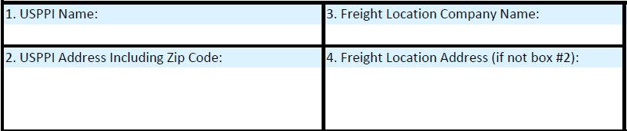
Field 1 through Field 4
Shipper’s Name, Address, Freight Location Company and Freight Location Address (if applicable)
Notes:
Field #1 is the USPPI Name. USPPI is the acronym for United States Principal Party in Interest. It is generally the name of the company or person in the USA who receives the primary benefit of the export transaction, meaning the entity that is making money from the sale of the goods that are being shipped. Please note that it is NOT permitted to be noted as “Company A in care of Company B”.
Field #2 is the address of the USPPI. This is normally the US Headquarters or US Corporate offices. The complete address including zip code must be inserted here. It MUST be a physical address, post office boxes are NOT acceptable. The address is generally the address that is appearing on the commercial invoice.
Field #3 – there are occasions that the shipper does not physically have the freight in their facility but instead it is coming from YOUR supplier’s distribution or warehouse facility. If this is the situation for this shipment, the Name of the company where the freight is being picked up (if it is not the same as the USPPI) is to be inserted in Field #3.
Field #4 – If the shipment is originating its journey from a location DIFFERENT from that specified in Field 2, the address of where the shipment is located is to be entered in this field. For example, if the USPPI principle address is in Boston, MA but the goods are being dispatched from YOUR warehouse in Providence, Rhode Island, the address of the facility in Providence, Rhode Island it to be inserted here. If it is coming from your supplier’s facility, the address of the supplier (shown in Field #3) is to be inserted here.
We need to have this information to ensure that we properly complete the Automated Export System filing as well as to comply with US Government security regulations.

Slide 7
Field 6 through Field 9
USPPI EIN (IRS) No, Related Parties,
Routed Transactions
Notes:
Field 6: We are required to have the EIN of the USPPI (Shipper) on file.
Field 7: Related Party indicator – if the USPPI (company listed in Box 1) owns 10% or more of the ultimate consignee (or if the Ultimate consignee owns more than 10% of the USPPI, you are considered related entities by the US Government. Check the “Related” box if this is applicable.
If there is less than 10% ownership (in either direction) this transaction is classified as “Non-Related”
Field 8: USPPI Reference # This field is optional. You may enter your internal control number (for example, a purchase order number; commercial invoice number or similar) in this field.
Field 9: Routed Export Transaction If you, as the shipper, are choosing the freight forwarder and control the movement of the shipment, this transaction is classified as a NON ROUTED shipment and you should select NO.
If the buyer or his agent at destination has selected the US Freight forwarder and is involved with making the decisions on the movement of the shipment, this transaction is classified as a ROUTED Transaction and you must select YES.

Slide 8
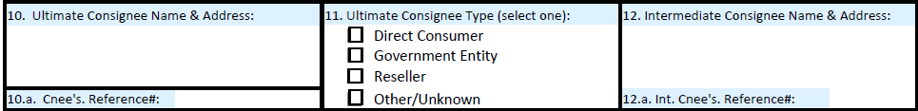
Field 10 through Field 12.a
Ultimate Consignee, Ultimate Consignee type; Intermediate Consignee
Direct Consumer – a NON-Government institution or enterprise or company that will consume or use the exported goods as a consumable, for its own internal processes as an input to the production of another good or as machinery or equipment that is part of a manufacturing process or a provision of services and will NOT resell or distribute the goods.
Government entity – a government-owned or government-controlled agency, institution, enterprise or company.
Reseller – this is a NON-Government entity -- for example a retail store, a wholesaler, distributor, trading company, a reseller of the goods .. all independent of the government.
Other/Unknown – this would apply to an entity that does not fall under the 3 classifications noted above: This choice should only be used in rare and exceptional cases as the above classifications cover virtually all consignees.
Notes:
Field 10: Ultimate Consignee Name and Address enter the complete name and address including COUNTRY of the person/entity at the destination who will be receiving the shipment at destination. It is generally the buyer of the goods but could also be the “ship to party” that is indicated on the Commercial Invoice and Packing List. It is NOT the destination Freight Forwarder.
If the shipment is covered by an export license, it is the person/entity designated on the export license. Items covered by ITAR will be the “Foreign End User”
Field 10A: Ultimate Consignee Reference # -(Optional) - this may be the consignee’s purchase order number or other reference number that he has assigned to the shipment.
Field 11: Ultimate Consignee Type….This data element was required by the US Government as of April 5, 2014. The definitions of the types are:
Direct Consumer – a NON- Government institution or enterprise or company that will consume or use the exported goods as a consumable, for its own internal processes as an input to the production of another good or as machinery or equipment that is part of a manufacturing process or a provision of services and will NOT resell or distribute the goods.
Government entity – a government-owned or government-controlled agency, institution, enterprise or company.
Reseller – this is a NON-Government entity -- for example a retail store, a wholesaler, distributor, trading company, a reseller of the goods .. all independent of the government.
Other/Unknown – this would apply to an entity that does not fall under the 3 classifications noted above: This choice should only be used in rare and exceptional cases as the above classifications cover virtually all consignees..
Field 12: Intermediate Consignee Name and Address The intermediate consignee is an entity in a foreign country that is acting as an agent for the PPI (Principal Party in Interest) or the Ultimate Consignee for the purpose of effecting delivery of the export shipment to the ultimate consignee.
If the shipment is being exported under an Export License, the details of the entity noted on the Export License as the intermediate consignee are to be entered in field 12. If the shipment is moving with a Letter of Credit, the bank would be considered the intermediate consignee.
Field 12A: Intermediate Consignee’s reference number (if applicable) is inserted here

Slide 9
Field 13 through Field 19
State of Origin, Country of Ultimate Destination, Hazardous Material, In-Bond Code, Entry Number, FTZ Identifier, Form of Payment
Field 16: In-Bond Code
If the cargo is NOT MOVING IN BOND – indicate “70” – Not in Bond.
If the cargo IS MOVING IN BOND, one of the following are to be utilized:
36 = warehouse withdrawal for immediate export (IE)
37 = warehouse withdrawal for transportation and exportation (T & E)
67 = IE from a Foreign Trade Zone (FTZ) FTZ identifier must be inserted in Field 18
68 = T&E from a foreign trade Zone (FTZ) FTZ identifier must be inserted in Field 18
Notes:
Field 13: State of Origin – this is the US State where the cargo originated it’s journey which therefore it is the state where the cargo has been picked up. If field 4 (above) is completed, please indicate the state that is in field 4. If Field 4 is blank, then indicate the state that is inserted in Field 2.
Field 14: Country of Ultimate Destination -- by definition “ country of ultimate destination is the country in which the goods are to be consumed, further processed, stored or manufactured, as known to the USPPI at the time of export. Generally this will be the country where the Ultimate Consignee is located. If the shipment is covered by a State Department License it is the country of the end user as specified on the license.
Field 15: Hazardous Material… Are the goods being shipped considered Hazardous Cargo (HAZMAT, Dangerous Goods) as defined by the US DOT? Check the appropriate box… (YES/NO). If the answer is YES, you must supply an IATA Dangerous Goods Declaration and MSDS for the dangerous goods.
Field 16: If this cargo is moving “In Bond” indicate the BOND TYPE CODE
If the cargo is NOT Moving in BOND – indicate “70” – Not in Bond.
In Bond Codes are:
36 = warehouse withdrawal for immediate export (IE)
37 = warehouse withdrawal for transportation and exportation (T & E)
67 = IE from a Foreign Trade Zone (FTZ) . FTZ identifier must be included in Field 18
68 = T&E from a foreign trade Zone (FTZ) FTZ identifier must be indicated Field 18
Field 17: Entry Number – If the goods were imported and proof needs to be supplied for the re-export of the goods, enter the import entry number. (Examples, drawback, Temporary Import Under Bond (TIB), ITAR license exemption 123.4(a). If the goods are being withdrawn from a bonded warehouse or FTZ for export, the inbond entry number also must be supplied.
Field 18: FTZ identifier – 7 character FTZ identifier – must be completed if the shipment is originating from an FTZ
Field 19: Form of Payment. Select Prepaid/collect/third Party Billing. Collect and Third Party Billing are subject to approval by Walker International Transportation. Extension of Credit to shippers is subject to approval by WIT.

Slide 10
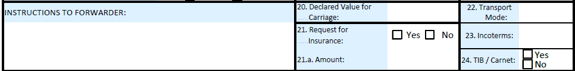
Field 20 through Field 24 & Handling Instructions
Instructions to Forwarder; Declared Value for Carriage, Request for Insurance; Transport Mode; Incoterms; TIB/Carnet
Transport Mode:
Insert one of the following:
AIR
OCEAN
TRUCK
RAIL
Incoterms:
EXW CPT
FCA CIP
FAS DAT
FOB DAP
CFR DDP
CIF
www.foreign-trade.com/reference/incoterms.cfm
Notes:
INSTRUCTIONS to FORWARDER : indicate in this field all particular handling instructions that you require. For example, temperature range or minimum/maximum temperature requirements. If DG indicate the UN # and packing instruction.
Field 20: Declared Value for Carriage If you do not wish to accept the limits on the carrier’s legal liability as specified in the Terms and Conditions, then you may indicate a declared value for carriage which will include an additional fee for the cost of transportation. Please note that this is not the same as purchasing “all risk insurance”. We recommend that “all risk” insurance be purchased for your shipment to make you financially whole in the event that the shipment is not delivered at destination in good order. Walker International can arrange insurance for you.
Field 21: Request for insurance If you would like to purchase ALL Risk Insurance, please check YES.
Field 21 A: Indicate the amount to be insured. All insurance is subject to acceptance by the Insurance Carrier’s underwriters. Your Walker representative can inform you the cost for insurance.
Field 22: Transport Mode -- please indicate the mode of transport – air, ocean, truck, rail
Field 23: Incoterms – indicate the International Commercial Terms applicable to the shipment. EXW = Exworks; FCA = Free Carrier; Details on the Incoterms may be found at
http://www.foreign-trade.com/reference/incoterms.cfm
Field 24: TIB/CARNET -- Is this shipment a Temporary Import under Bond (TIB) movement or covered by a Carnet?
Yes/NO -- if YES is indicated the entry or CARNET number must be entered into Field 17.

Slide 11
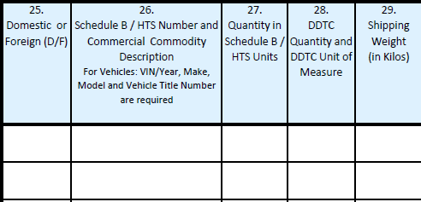
Field 25 through Field 29
Domestic/Foreign Indicator, Schedule B / HTS Number, Goods Description, Schedule B/HTS Units; DDTC Quantity/Units; Shipping Weight
Schedule B look-up: https://uscensus.prod.3ceonline.com/
Notes:
Field 25: Domestic or Foreign (D/F) – indicate the origin - Domestic or Foreign (D or F)… Goods are considered Domestic if the merchandise was grown, produced, or manufactured in the US (including imported merchandise that was enhanced in value or change in form from which it was imported by manufacturing or processing in the USA… for example, a computer consisting of foreign made parts, but assembled in the USA would be classified as domestic as the various parts were put together here which increased their value.)
Field 26: Schedule B/ HTS Number and commercial commodity description. For vehicles include VIN/YEAR/MAKE/MODEL/Vehicle Title Number. Indicate, if known the Schedule B number. Also state a COMMERCIAL commodity description – possibly the description used on the commercial invoice or packing list. Do NOT use the Schedule B description.
Field 27: Quantity in Schedule B/ HTS Units ….. Note that the Schedule B Units may NOT be the weight of the shipment (field 29). It could be the number of actual units (possibly pieces) or some other quantity as specified in the Schedule B.
Field 28: DDTC Quantity and DDTC Unit of Measure
DDTC = Directorate of Defense Trade Controls, Department of State. If the shipment is covered by a DDTC license or license exemption type, the DDTC Quantity (units of measure) which may be different from the Schedule B Quantity, is to be reflected here. This quantity may be found on the Export Authorization or under the ITAR exemption.
Field 29: Shipping Weight (IN KG) -- this is the actual weight of the shipment, including the packaging and skids. The weight is to be report in Kilos.

Slide 12
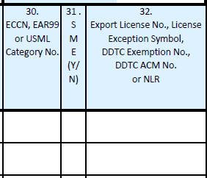
Field 30 through Field 32
ECCN, EAR, USML Category, SME, Export License or Exemption
See the AES DIRECT website for quick reference list of the codes: https://aesdirect.census.gov/support/reference.html
ECCN Number are found in the COMMERCE CONTROL LIST in the Code of Federal Regulations 15CFR744
USML Category No is found in 22CFR121 US Munitions List
Notes:
Field 30: ECCN, EAR99 or USML Category No
ECCN = Export Control Classification Number USML = United States Munitions List
EAR99 is the general “catch-all” classification number assigned to any item that is subject to the EAR but that does not have a specific export control classification number listed in the Commerce Control list. By far, the vast majority of U.S. origin goods are classified as EAR99, and under most circumstances, do not require a license for export. The Commerce Control List can be found in the Code of Federal Regulations 15CFR744.
For commodities subject to the EAR (Export Administration Regulations), indicate EAR9 or report the ECCN number. ECCN is required if: Goods are being exported under a BIS license or license exception or the goods are classified on the CCL (commerce control list)have a reason for control other than Anti-terrorism and are being exported as NLR (No License Required).
For commodities subject to the ITAR, report the U.S. Munitions List (USML) category.
Field 31: SME = Significant Military Equipment. This term is used to designate articles on the USML for which special export controls are warranted because of their capacity for substantial military utility or capability. If the DDTC license or license exemption type was selected, indicate if the commodity is considered SME. Y/N
Field 32: Export license No, License Exception Symbol, DDTC Exemption NO, DDTC ACM No or NLR
Indicate as applicable: validated license number ( Department of Treasury, OFAC (office of foreign assets control), Department of Justice, DEA (Drug enforcement agency permit),or any other export license number issued by a Federal government agency.
Consult the AES Direct website at HTTPS://aesdirect.census.gov/support/reference.html for descriptions for all the applicable codes for Department of Commerce CCL (Commerce Control list) or the State Department, Office of Defense Trade Controls, USML, License Exception symbols – EAR license exceptions are BAG (baggage), GFT (gift parcels and humanitarian donations); AVS (aircraft and Vessels); GOV (governments and international organizations); TSR (technology and software under restriction) TMP (Temporary Imports, Exports and re-exports. ( EAR – 740.1; 740.2; 758.1 )
Enter NLR indicator (No License Required) when items that are being exported are subject to the EAR but not listed on the CCL (Commerce Control list) – these are items that are normally classified as EAR99.

Slide 13
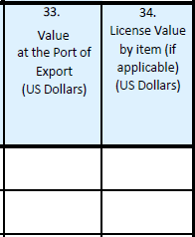
Field 33 through Field 34
Value at Port of Export, License Value
Include the selling price or cost (if not sold); inland freight (pre-export); insurance; any other charges that may be incurred prior to the arrival at US port of export.
This is the cost of the goods only. It does not include inland freight (pre-export); insurance; any other charges that may be incurred prior to the arrival at US port of export.
Notes:
Field 33: Value at the Port of Export (US Dollars). The value indicated in this field is the selling price or cost (if not sold) and is to include Inland Freight (pre-export), insurance and any other charges or expenses to the US port of export. Report one value for each Schedule B number.
Field 34: License Value by item (if applicable) (in USD) If the goods are being exported under an export license, the license value is to be reflected. The license value is limited to the value of the goods being exported (excluding domestic freight, insurance or other charges) This value will generally be less than the value indicated in Field 33.

Slide 14
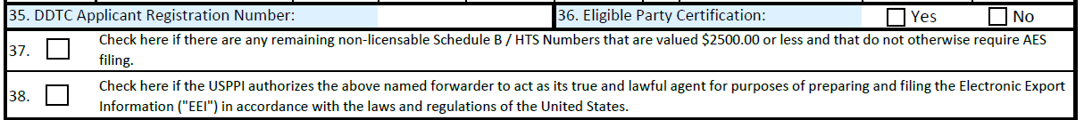
Field 35 through Field 38
DDTC Applicant Registration No, Eligible Party Certification, Goods under $2500, Authority to File EEI (AES)
Notes:
Field 35: DDTC applicant registration number, For shipments where a DDTC license or license exemption applies, the registration number that has been established by the DDTC for the exporter is to be inserted in field 35.
Field 36: eligible party certification (Y/N)
If a DDTC license exemption applies, the exporter must certify if he/she is an eligible party to participate in defense trade. If the exporter is not eligible, the shipment cannot be exported.
Field 37: If there are NON Licensable Schedule B/HTS numbers for goods valued $2500 or less that are not listed on this SLI, please check YES. (An AES filing is not required for these goods). If the entire shipment is listed on this SLI, check NO.
Field 38: Check here if the USPPI authorizes the Walker International Transportation LLC to act as its true and lawful agent for purposes of preparing and filing electronic Export Information (EEI) I accordance with the laws and regulations of the United States. If you have submitted a blanket Power of Attorney for Export Transactions this box can be left unchecked.

Slide 15
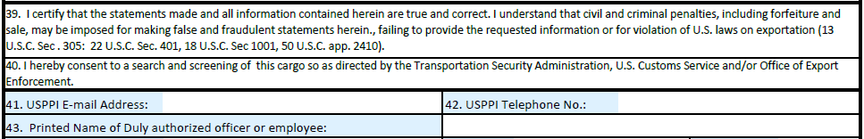
Field 39 through Field 43
Certifying statement, Consent to Screen, Email, Telephone, PRINTED Name Authorized Officer or Employee
Notes:
Field 39: signature in box 44 is certifying this statement..
Field 40: signature in box 44 is granting authorization.
Field 41: USSPI Email Address Email address of the person completing /signing this SLI
Field 42: USPPI Telephone Number - telephone contact of the person completing/signing this SLI
Field 43: Printed Name of Duly authorized officer and employee – enter the name of the individual who is authorized to complete this SLI (individual whose signature is appearing in field 44)

Slide 16
Field 44 through Field 47
Signature, Title, Date, Electronic Signature Validation
Notes:
Field 44: Signature -- actual signature or if signing electronically, enter the name of the individual who is “signing” this SLI in ALL CAPITAL LETTERS.
Field 45: Title (title/position of the individual who signed field 44
Field 46: Date (date the SLI has been prepared)
Field 47: Check here to validate electronic Signature electronic signatures must be typed in all capital letters in Box 44 in order to be valid. If the signature on this form is “electronic” then Field 44 must be entered in ALL CAPITAL letters and the box in field 47 must be checked.

